Slide 1
99th EUROPEAN ORTHODONTIC SOCIETY CONGRESS 9-13 JUNE 2024 ATHENS, GREECE
www.eos2024.com

Slide 4
The European Orthodontic Society is excited to announce the 99th European Orthodontic Society Congress in Athens, 9-13 June 2024 and everyone is invited to participate!
#EOScongress24 will bring together:
Orthodontic practitioners
Professionals with an interest in orthodontics
A scientifically orientated orthodontic audience
Postgraduate students of related subjects
Industry representatives
Oral and poster presentations
You will also enjoy:
An exhibition of a wide range of orthodontic and
dental products, as well as new technological developments in orthodontics
A platform for new researchers to showcase their abstracts
Historic sites where the arts and science flourished more than 5000 years ago, to discover and appreciate the progression of our civilization, from its beginnings to the present day
Join us for a memorable scientific and cultural experience at the 99th Congress of the European Orthodontic Society in Athens!
See programme, sponsorship opportunities and registration www.eos2024.com
Follow us on social media: engage, post and share #EOScongress24
@EuroOrthodontic @EuroOrthondonticSoc @European-orthodontic-society-eos

Slide 5
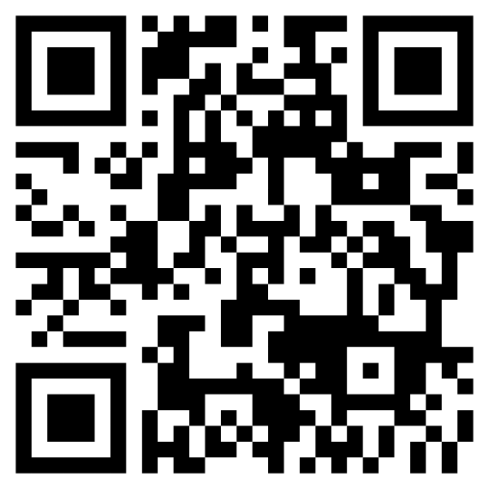
#EOScongress24 REGISTRATION OPEN Early bird deadline: 5 April

Slide 6
Become a sponsor
Join #EOScongress24 as a sponsor and showcase your brand

